Slide 1


Home Security
(A cloud based Security application Application)

Slide 2
WHAT IS HOME SECURITY?
Home Security is a security application that will protect your private and valuable documents in your absence.
It is a web based camera application that uses a technology called Computer Vision.
It is written purely in java which makes it platform independent.
It has two modules-
1. A web application that is deployed on cloud.
2. A core application that will run onto a local computer where the camera is installed.
3. optional raspberry pie 3B.

Slide 3
Why Home Security?
Today the crime rate is exceeding day by day and in this competitive world, security is one of the major concerns.
Now a days the the family is becoming nuclear , and in most of the both the elder members in the family are working leaving home alone or with their children . Whenever they are away they feel the concern about security . In many situation one of the family member has to stay at home or even some time we refuses for some happening moment for this concern .
We understand you and your tensions regarding your home and valuable documents in your absence, so we made this application that will help you to reduce your headache regarding your private important document and hard working penny.
Home Security is one of that security masters that will not let you and your family unsecured. It will protect your family and your important document and property from theft and illegal access by keeping an eye on them.

Slide 4
Features Of Home Security?
One Can access the settings of camera from any part of the world through internet (Email validation).
You can start the detection mode from the core desktop application or from the web application.
The detection mode triggers various events in case of any motion.
You can get alerts when there is motion in front of camera (SMS alert).
View the captured images online through web application.
Register mobile numbers on to which you want to get alerts during detection.

Slide 5
About Home Security Web Application.
The web application is designed in HTML, Bootstrap and Javascript with JSP as core of all that made it all working.
You can access the web application through a URL which is https://securehome.mybluemix.net.
You can enjoy free trial with basic services by making your user account here to start using the application.
You can purchase various services according to your need online.
You can change your settings any time.
After setup it will monitor the home and let you alert and let you access live feeds where ever you will be in globe
Provide a perfect security application

Slide 6
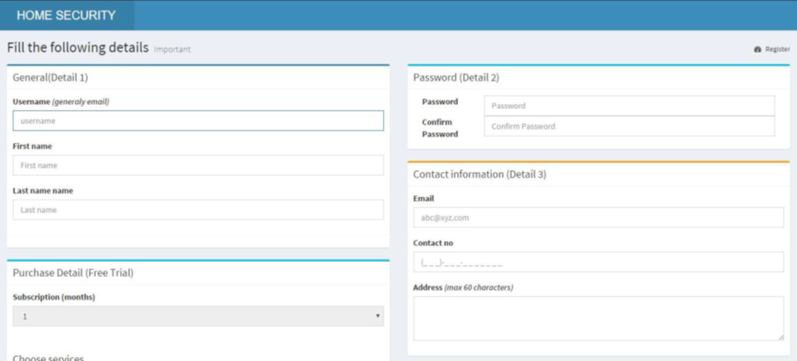
Web Application Signup Page…

Slide 7

Web Application Login Page…

Slide 8
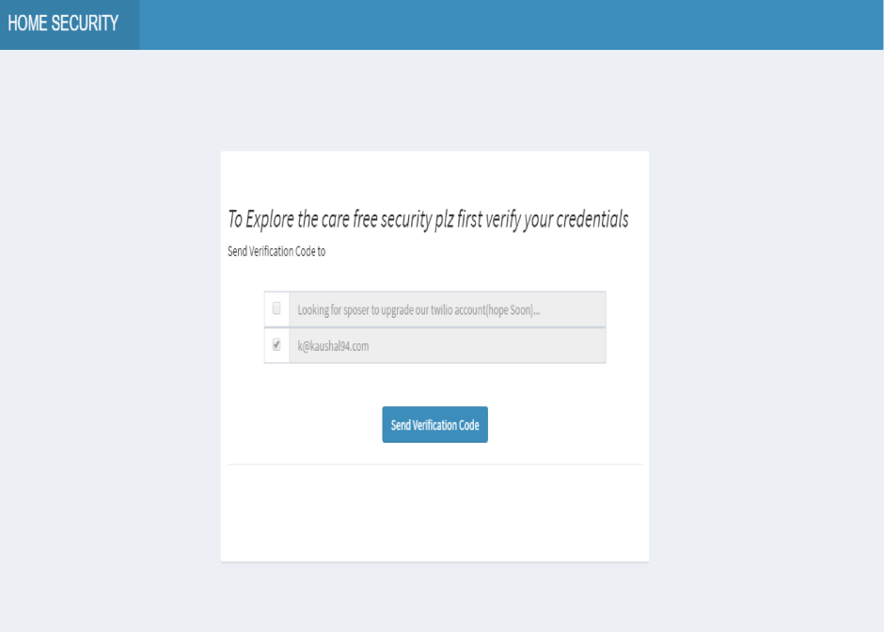
Email validation phase
Request for email verification
Applying verification code

Slide 9
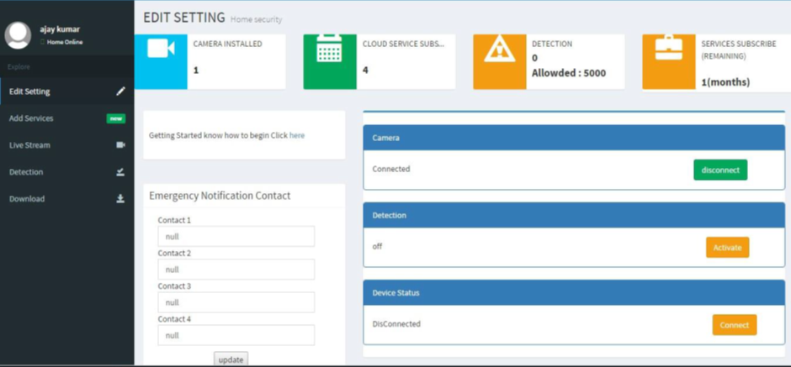
Web Application Services page…

Slide 10
About Core Application…
The core application is totally written in java.
It has used java FX for its GUI and core java for its working.
It has used Open CV API code for its camera module.
Being Written in java, it is platform independent.
You can Login your account to start monitoring.

Slide 11
Core Application View…

Slide 12
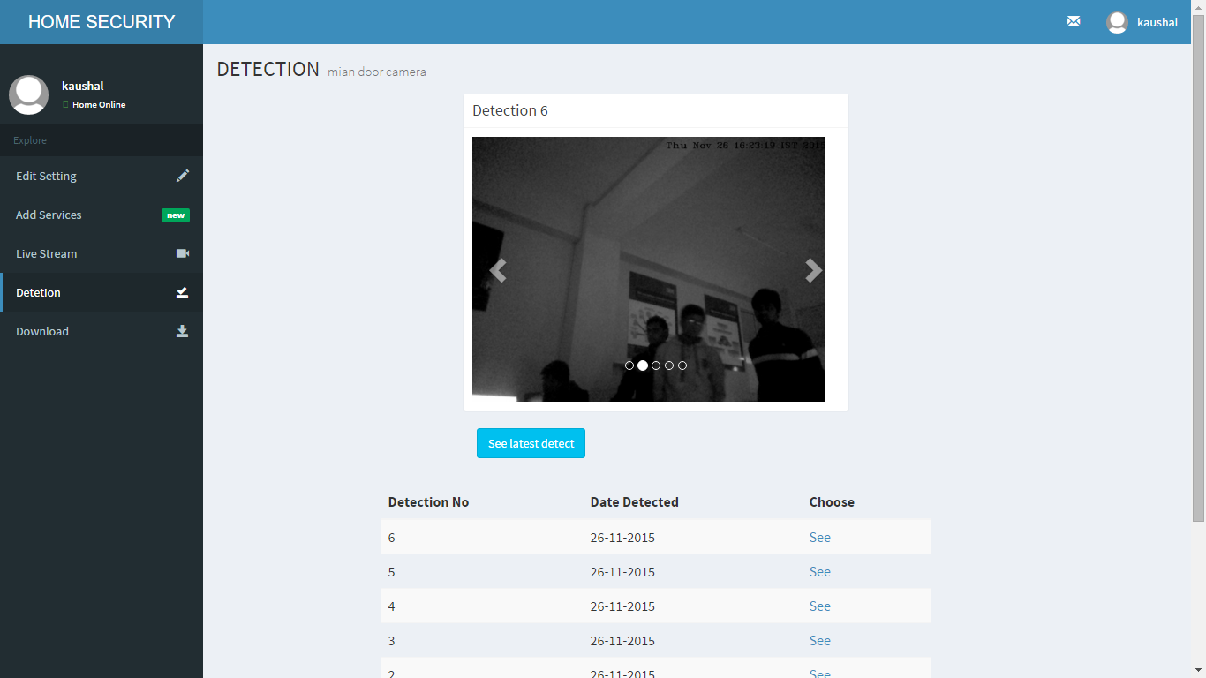
Detected Image from Core Application

Slide 13
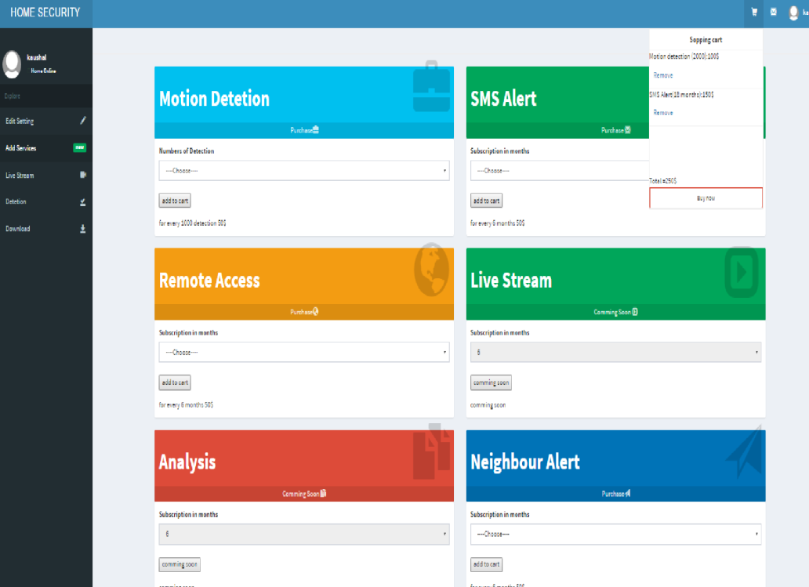
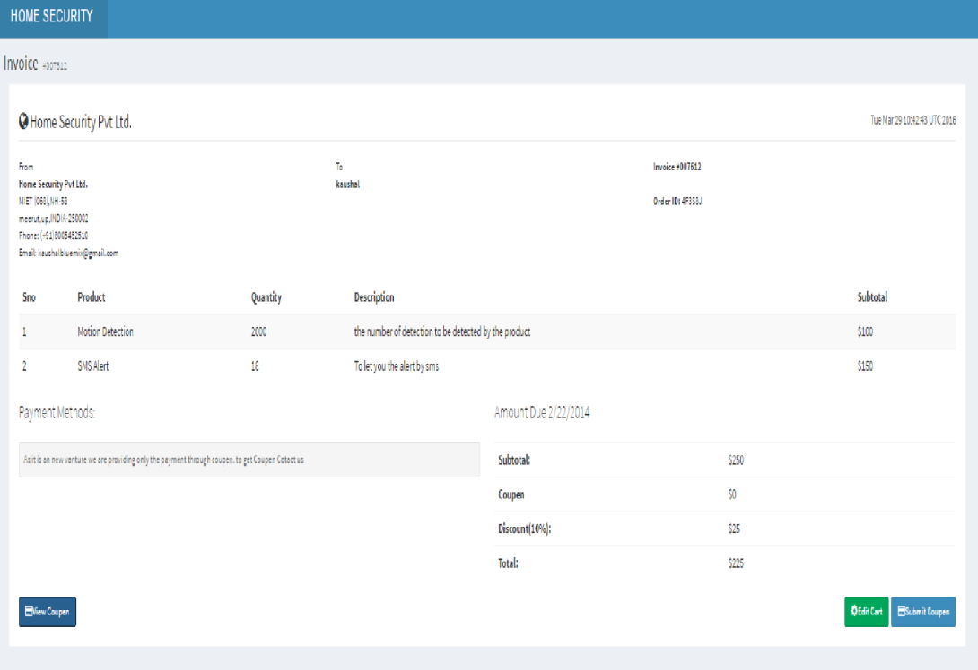
Adding services
Adding various services to cart
Purchasing service Payment page

Slide 14

Live Streaming raspberry pie Setup
Raspberry pie setup with usb camera facing door

Slide 15
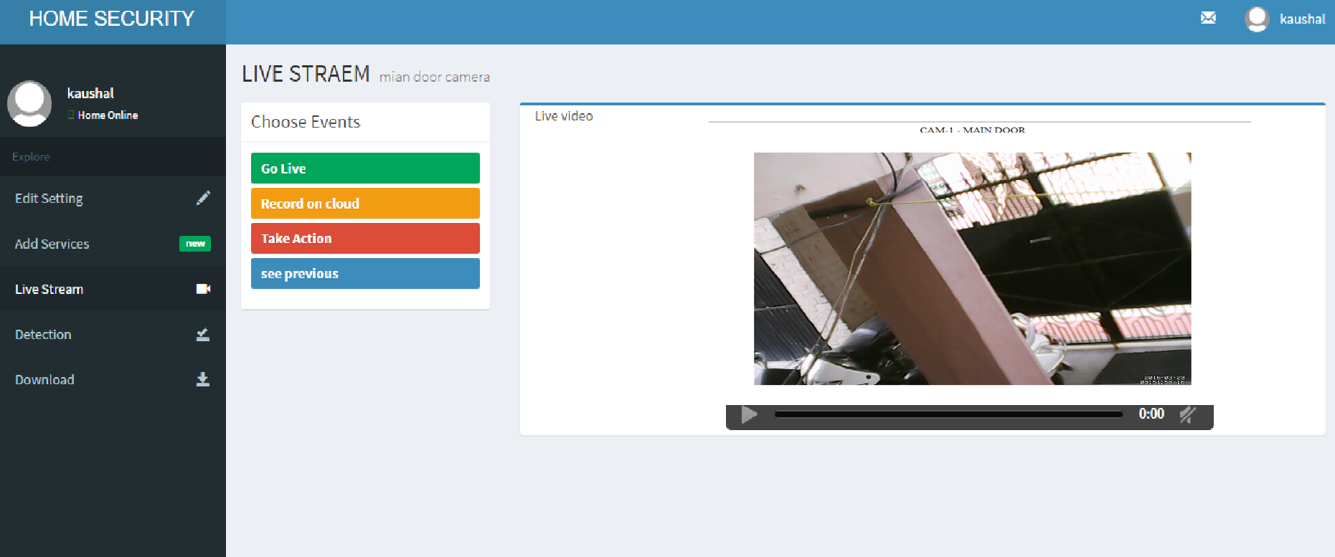
Live Streaming through Raspberry pie 3

Slide 16
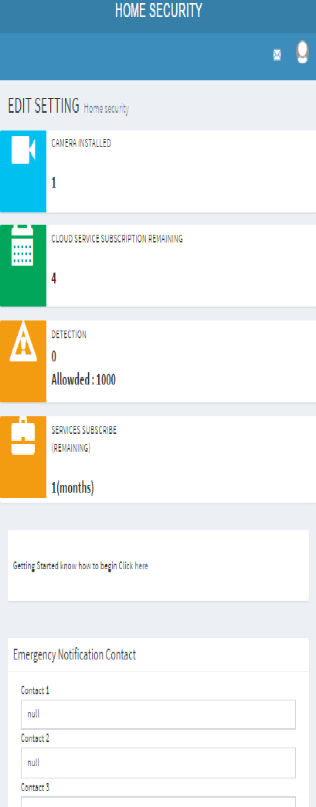
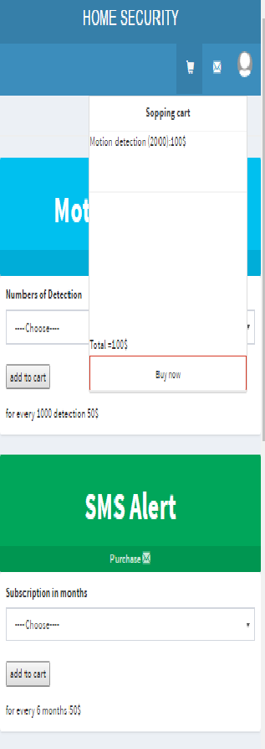
Mobile application Screen short
User control panel
Adding services to cart for purchase

Slide 17
Bluemix service -1-Twilio SMS
Twilio SMS integrated service of the IBM cloud is been used for the detection alert purpose and the alert for the “notify neighbour service ”

Slide 18
Bluemix service -2-Send Grid mail service
We uses the IBM Send Grid Mail service of the ibm bluemix for news updates , for email validation for cheking the identity og the user
We integrate the mail to provide digital signature of our domain .

Slide 19
Bluemix service – 3 –Dash DB Database
We uses the dash DB Database as a flexible data backhand for our application providing the backhand data storage for both web app as well as core app

Slide 20
Bluemix service – 4 –Monitoring and Analysis
Use the Monitoring And Analysis service for active measuring and seen the various health and performance measure of the web app deploy on the IBM Bluemix

Slide 21
Working Of Home Security.
You have to register yourself on the web application for getting a username and password.
After getting the username and password you can download the core application setup file from the website.
After downloading the core application from the website launch it by double clicking on it. A window will open up which will ask your username and password.
Enter your username and password to start the camera and other monitoring services. The detection mode then can be enabled by the website.
When there will be any motion during detection mode it will capture images and will store it on the web server where you can view all detected images with date and time though the website by just logging into your account. Also during detection, you will get an alert that there is an illegal activity with the date and time of detection in the message.

Slide 22
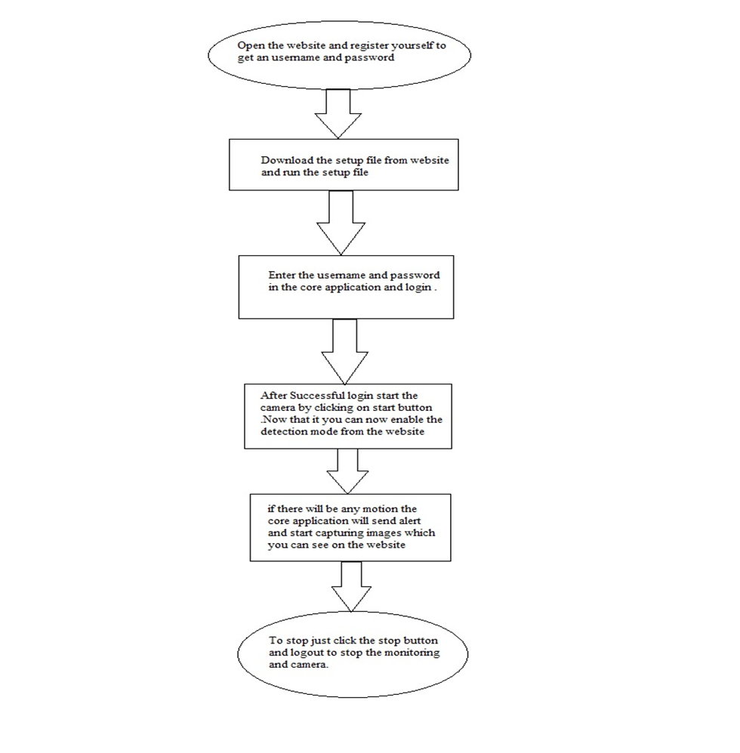
Working (continued)

Slide 23
Hardware Requirements For Running The application…
RAM : Min 1 GB
Hard Disk Space : 40 GB
Processor : Pentium 4 (or higher) or equivalent AMD
Screen Resolution :1024 x 768
Digital Camera with a good resolution .

Slide 24
Software Requirements For Running The application…
Operating System : Windows 7 (or later)
Java Virtual Environment
Open CV 3.0.0
Camera Compatible Drivers

Slide 25
Additional Setting For Setup Purpose..
Install Open CV 3.0.0 which can be downloaded from GitHub website.
Set the path of open CV in the System Environment Variable where you have installed the Open CV as (installed directory/build/x64 or x86/vc11 or vc12/bin).
Install Java Development Kit.
For Linux based OS, instead of downloading and running exe file run jar file through terminal.

Slide 26
Conclusion
For most thing it has the unlimited and unbound possibilities in future .
It will send alert to your registered mobile number and upload the detected images on to the web server which can be viewed on the web application. So Home Security is one of the powerful application that will help in detecting theft and restrict it by happening.
It will not only decrease the theft rate but also help in gathering theft information.
In sense as a computer science student we are putting our efforts to pay back our society by this as our duty .
Home Security is a must having application for every home and office and National Security (and …) so that you and your family can have a better sleep , enjoy happening moments and better future for tomorrow.

Slide 27
Presented By
Ajay Kumar (1206810016)
Gaurav Samant (1206810087)
Kaushal Kumar (1206810102)
Shashank Bharadwaj (1206810200)
Thanking You

